Slide 1
Project Status:
NAS Benchmark
Mohit Palliyil Sathyaseelan, Vishnu V

Slide 2
Overview
Five kernels
IS - Integer Sort, random memory access
EP - Embarrassingly Parallel
CG - Conjugate Gradient, irregular memory access and communication
MG - Multi-Grid on a sequence of meshes, long- and short-distance communication, memory intensive
FT - discrete 3D fast Fourier Transform, all-to-all communication
Three pseudo applications
BT - Block Tri-diagonal solver
SP - Scalar Penta-diagonal solver
LU - Lower-Upper Gauss-Seidel solver

Slide 3
Brief Description about the kernels
EP - Embarrassingly Parallel
is an Embarrassingly Parallel benchmark. It generates pairs of Gaussian random deviates according to a specific scheme. The goal is to establish the reference point for peak performance of a given platform.
MG - Multi-Grid on a sequence of meshes, long- and short-distance communication, memory intensive
uses a V-cycle MultiGrid method to compute the solution of the 3-D scalar Poisson equation. The algorithm works continuously on a set of grids that are made between coarse and fine. It tests both short and long distance data movement.
CG - Conjugate Gradient, irregular memory access and communication
uses a Conjugate Gradient method to compute an approximation to the smallest eigenvalue of a large, sparse, unstructured matrix. This kernel tests unstructured grid computations and communications by using a matrix with randomly generated locations of entries.
FT - discrete 3D fast Fourier Transform, all-to-all communication
contains the computational kernel of a 3-D fast Fourier Transform (FFT)-based spectral method. FT performs three one-dimensional (1-D) FFT’s, one for each dimension

Slide 4
Brief Description about the kernels
IS - Integer Sort, random memory access
Sort N keys in parallel The keys are generated by the sequential key
generation algorithm (A Pseudorandom Number Generator) and initially must be
uniformly distributed in memory The initial distribution of the keys can have a
great impact on the performance of this benchmark
BT - Block Tri-diagonal solver
is a simulated CFD application that uses an implicit algorithm to solve 3-dimensional (3-
D) compressible Navier-Stokes equations. The finite differences solution to the problem is
based on an Alternating Direction Implicit (ADI) approximate factorization that decouples
the x, y and z dimensions. The resulting systems are Block-Tridiagonal of 5×5 blocks and are solved sequentially along each dimension
SP - Scalar Penta-diagonal solver
is a simulated CFD application that has a similar structure to BT. The finite differences solution to the problem is based on a Beam-Warming approximate factorization that decouples the x, y and z dimensions. The resulting system has Scalar Pentadiagonal bands of linear equations that are solved sequentially along each dimension
LU - Lower-Upper Gauss-Seidel solver
is a simulated CFD application that uses symmetric successive over-relaxation (SSOR)
method to solve a seven-block-diagonal system resulting from finite-difference discretization of the Navier-Stokes equations in 3-D by splitting it into block Lower and Upper triangular systems.

Slide 5
Why NPB ?
NAS Parallel Benchmark are designed to evaluate Performance of Parallel supercomputers.
Different class size for NPB, will show the performance difference with change increase in number of ranks being used.
Benchmark Classes
Comparing serial AGM2013 output to NPB-IS class B. ( Just to show the data class comparison)
Call graph (explanation follows) - AMG2013
granularity: each sample hit covers 2 byte(s) for 0.56% of 1.80 seconds
Call graph (explanation follows) - NPB-IS Class B
granularity: each sample hit covers 2 byte(s) for 0.09% of 10.89 seconds
Class S: | small for quick test purposes
Class W: | workstation size (a 90's workstation; now likely too small)
Classes A, B, C: | standard test problems; ~4X size increase going from one class to the next
Classes D, E, F: | large test problems; ~16X size increase from each of the previous classes
https://www.nas.nasa.gov/software/npb.html

Slide 6
NPB MPI, OMP, CUDA
The NAS Benchmark are available in OpenMP, MPI, Serial programming and CUDA model.
Out of 5 kernels which performs specific CFD applications, IS kernel is the only one which performs on C code. EP,CG,MG,FT kernels are programmed in Fortan90. Although we have found OMP codes for the rest of the kernels in C.
Performance of HiperGator is compared to the other HPC as shown in NAS benchmark report
https://www.nas.nasa.gov/assets/pdf/techreports/1996/nas-96-018.pdf
https://www.nas.nasa.gov/software/npb.html

Slide 7
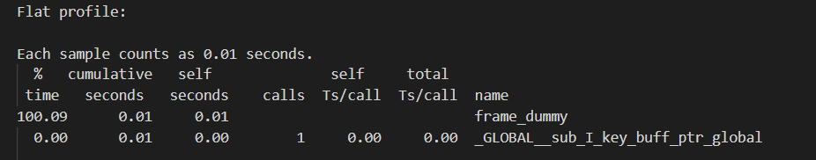
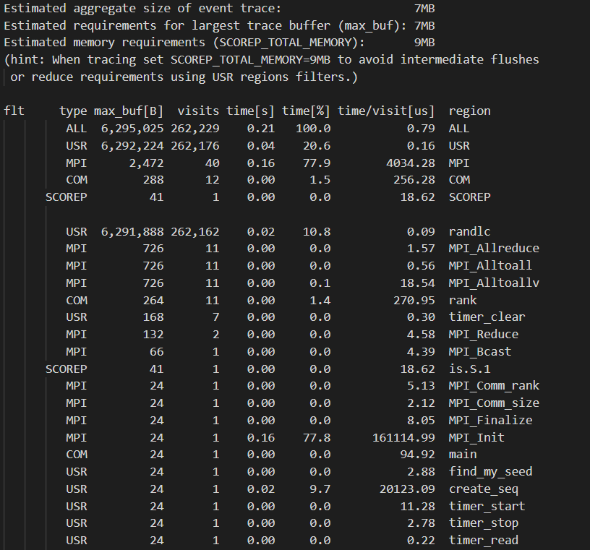
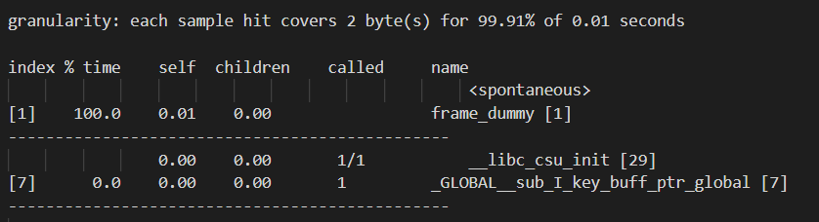

Profiling
Gprof
Gprof is a performance analysis tool for Unix applications. It used a hybrid of instrumentation and sampling and was created as an extended version of the older "prof" tool. Unlike prof, gprof is capable of limited call graph collecting and printing.
ScoreP
Score-P is a performance measurement infrastructure for profiling, event tracing and online analysis of (parallel) HPC applications. It allows users to instrument and record the behavior of sequential, multi-process (MPI, SHMEM), thread-parallel (OpenMP, Pthreads) and accelerator-based (CUDA, OpenCL) applications as well as hybrid parallel applications.
Fig1. Performance of Is kernel run with S class
Fig2. Performance of Is kernel run with S class

Slide 8
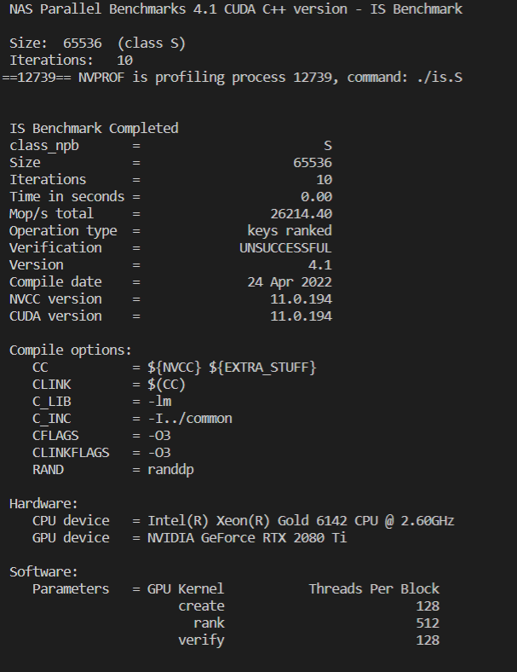
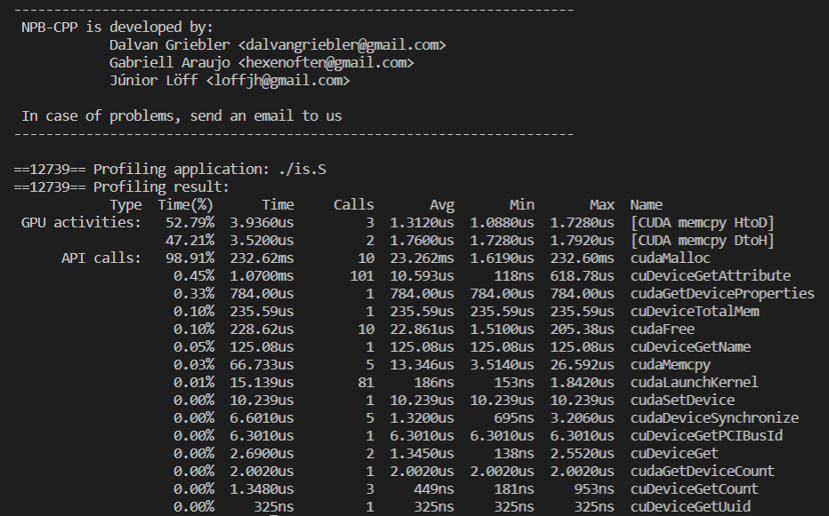
Profiling
nvprof
Nvprof is a command-line light-weight GUI-less profiler available for Linux, Windows, and Mac OS. This tool allows you to collect and view profiling data of CUDA-related activities on both CPU and GPU, including kernel execution, memory transfers, etc. Profiling options should be provided to the profiler via the command-line options.
Fig 3&4. Performance of Is kernel run with S class

Slide 9
Running the Kernels
MPI Codes :
make is NPROCS=2 CLASS=S [SUBTYPE="full"] //make sure which flags to add depending on the profiller you use; make.def file
For ScoreP
export PATH=$PATH:/home/mohit.palliyilsa/profiling/scorep/bin/ //changes should be made to make.def prior to this command
srun --mpi=pmix_v2 ./is.S.2
scorep-score -r scorep-is.S.2/profile.cubex
For Gprof
srun --mpi=pmix_v3 ./is.C.2
gprof is.C.2
OMP Codes :
make is CLASS=S Go to the bin directory and then mention number of threads you would like to use;
export OMP_NUM_THREADS=X
srun --mpi=pmix_v3 ./is.S
CUDA Codes :
srun --account=eel6763 --qos=eel6763 -p gpu --gpus=1 --time=03:00:00 --pty -u bash -i
module load ufrc
module load cuda
Make is CLASS=S
nvprof ./ex

Slide 10
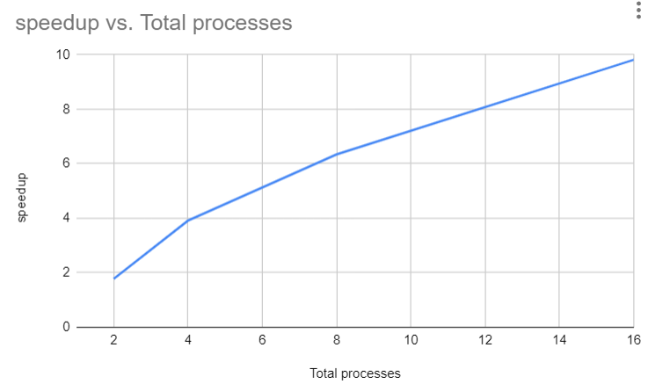
Results
Class C profiling using Gprof
Class = C
Size = 134217728
Iterations = 10
Time in seconds = 11.10
Total processes = 2
Compiled procs = 2
Mop/s total = 120.90
Mop/s/process = 60.45
Operation type = keys ranked
Verification = SUCCESSFUL
Version = 3.3.1
Compile date = 31 Mar 2022
granularity: each sample hit covers 2 byte(s) for 0.05% of 21.04 seconds
Class = C
Size = 134217728
Iterations = 10
Time in seconds = 5.04
Total processes = 4
Compiled procs = 4
Mop/s total = 266.12
Mop/s/process = 66.53
Operation type = keys ranked
Verification = SUCCESSFUL
Version = 3.3.1
Compile date = 31 Mar 2022
granularity: each sample hit covers 2 byte(s) for 0.11% of 9.01 seconds
Class = C
Size = 134217728
Iterations = 10
Time in seconds = 3.11
Total processes = 8
Compiled procs = 8
Mop/s total = 431.66
Mop/s/process = 53.96
Operation type = keys ranked
Verification = SUCCESSFUL
Version = 3.3.1
Compile date = 01 Apr 2022
granularity: each sample hit covers 2 byte(s) for 0.16% of 6.26 seconds
Class = C
Size = 134217728
Iterations = 10
Time in seconds = 2.01
Total processes = 16
Compiled procs = 16
Mop/s total = 667.20
Mop/s/process = 41.70
Operation type = keys ranked
Verification = SUCCESSFUL
Version = 3.3.1
Compile date = 01 Apr 2022
granularity: each sample hit covers 2 byte(s) for 0.28% of 3.54 seconds
Fig 5 Speed up for class C; Output from HiPerGator
https://www.nas.nasa.gov/software/npb.html

Slide 11
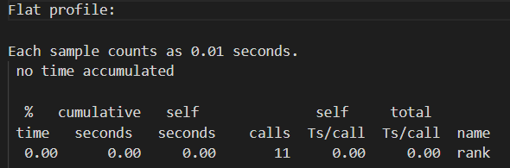
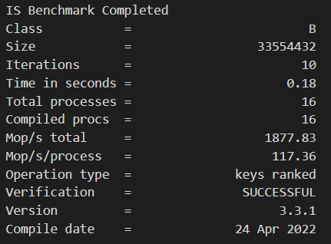
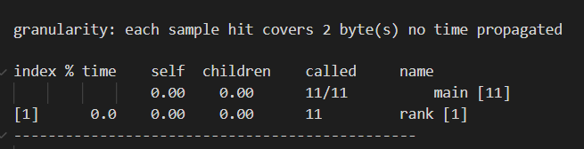
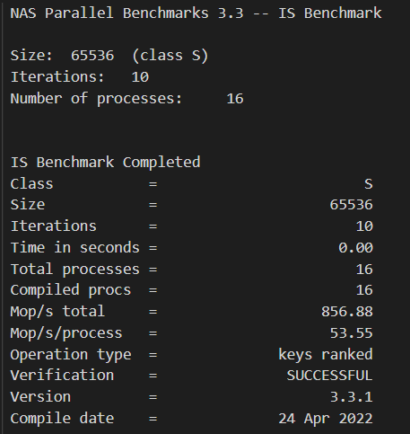
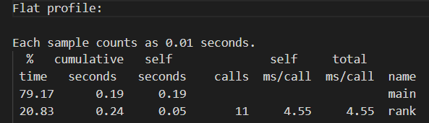
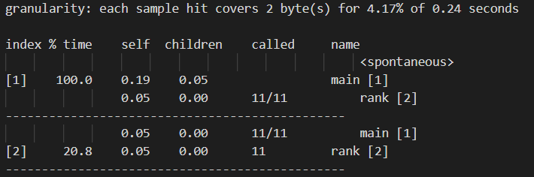
Results Gprof MPI
Fig 7 is.B.16
Fig 6 is.s.16

Slide 12
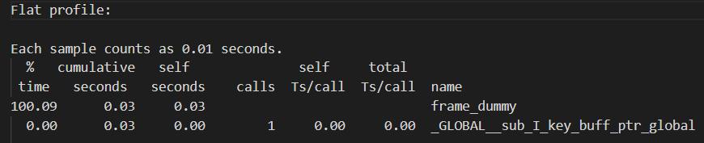
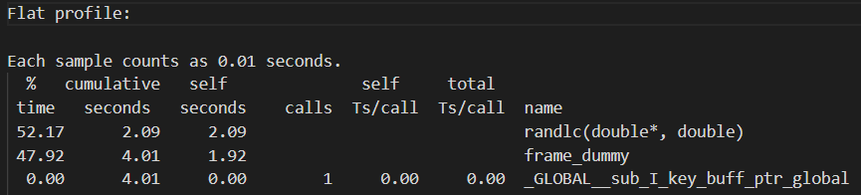
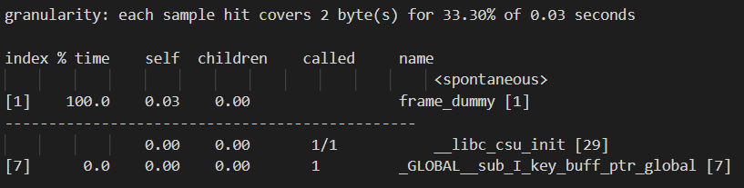
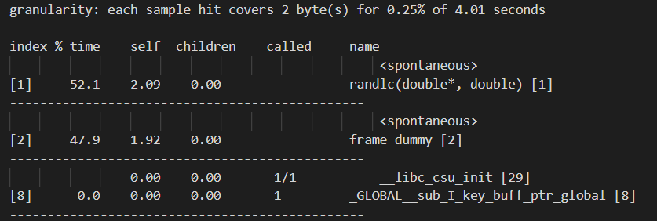
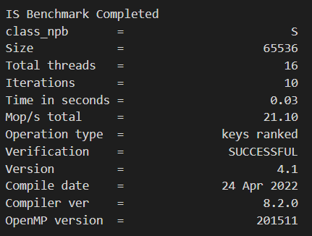
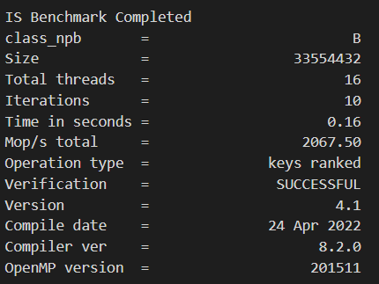
Results Gprof OMP
Fig 8 is.s.16
Fig 9 is.B.16

Slide 13
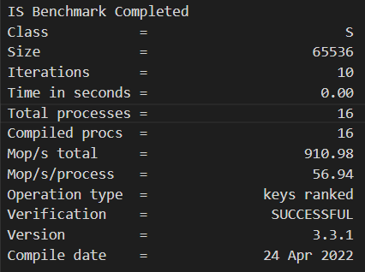
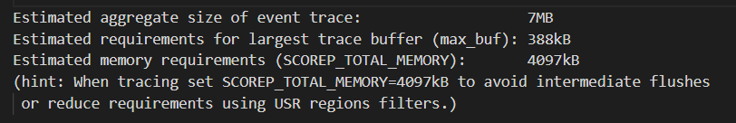
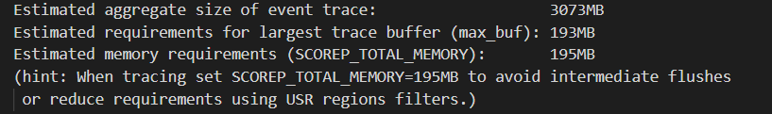
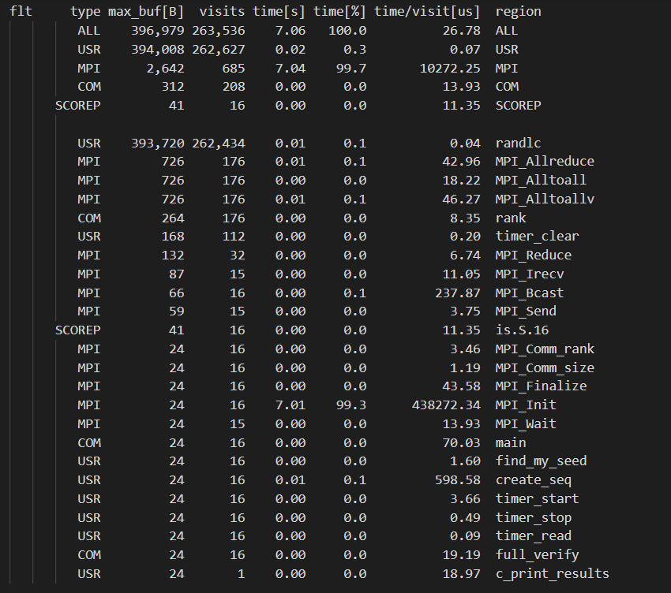
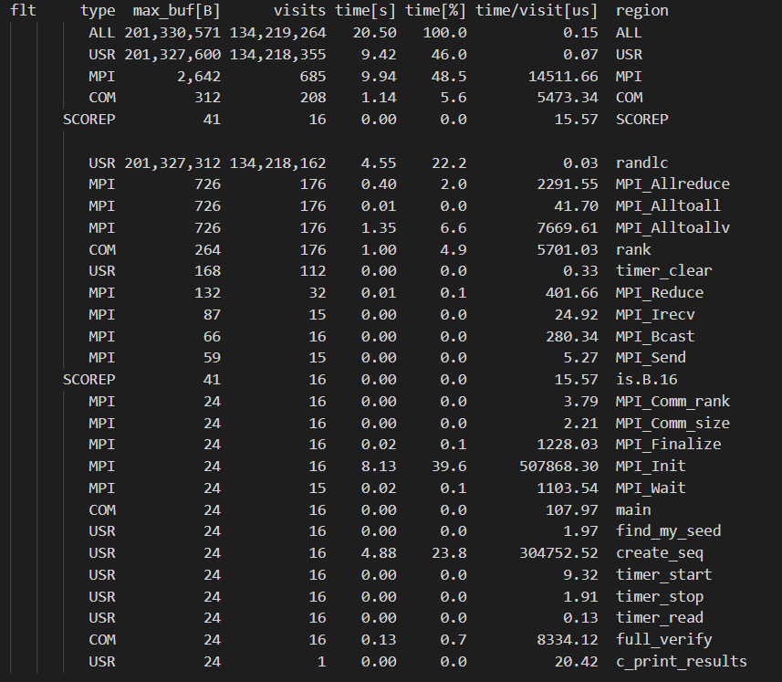
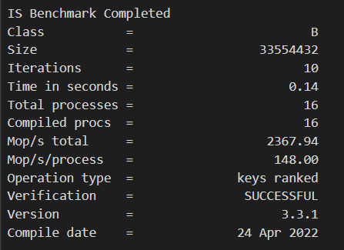
Results ScoreP MPI
Fig 10 comparison between is.S16 and is.B.16

Slide 14
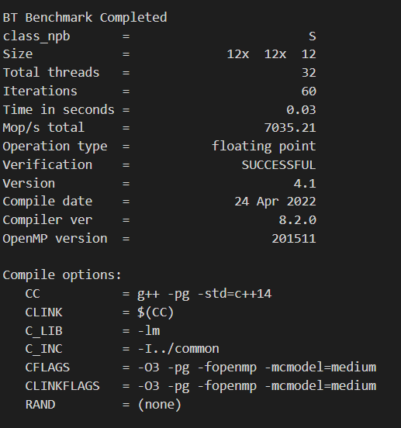
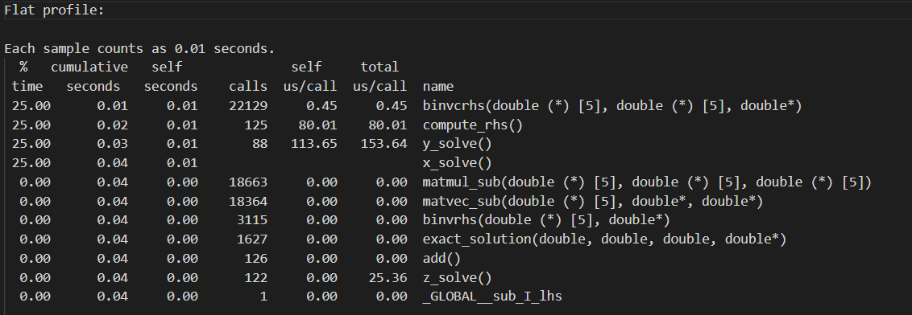
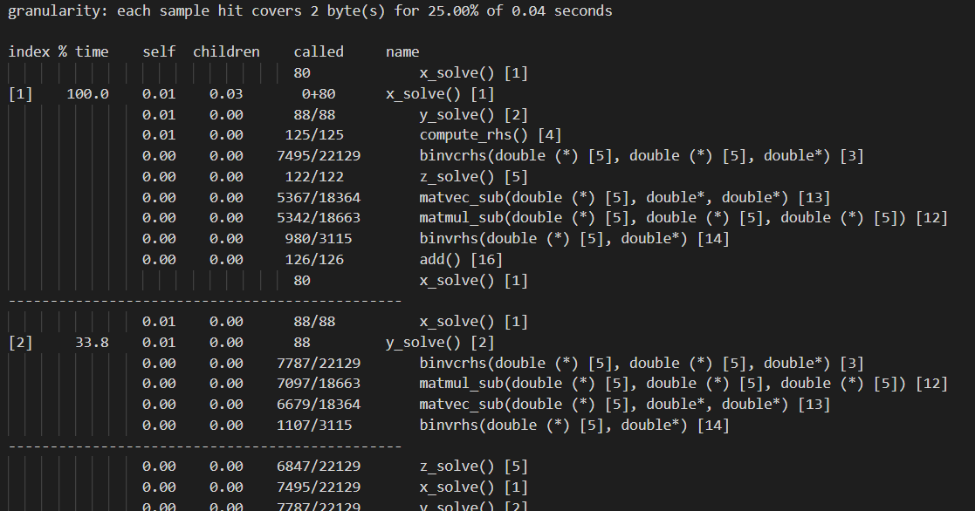
Results Gprof OMP
Fig 11 bt.S.32

Slide 15
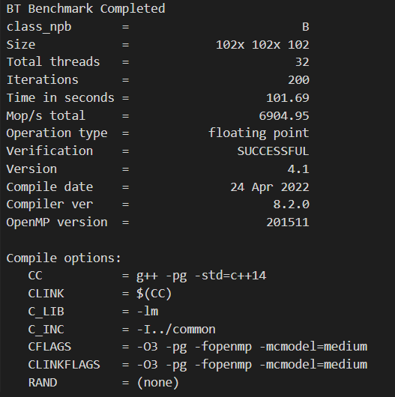
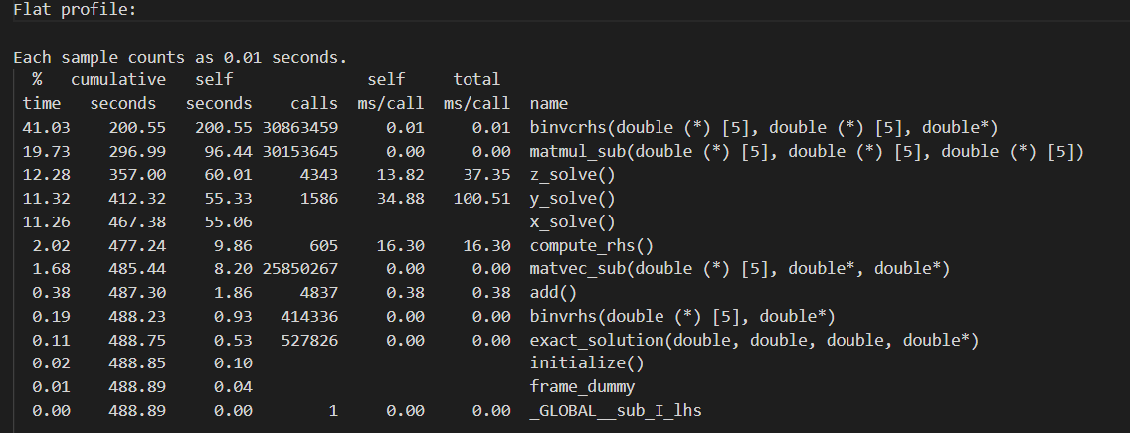
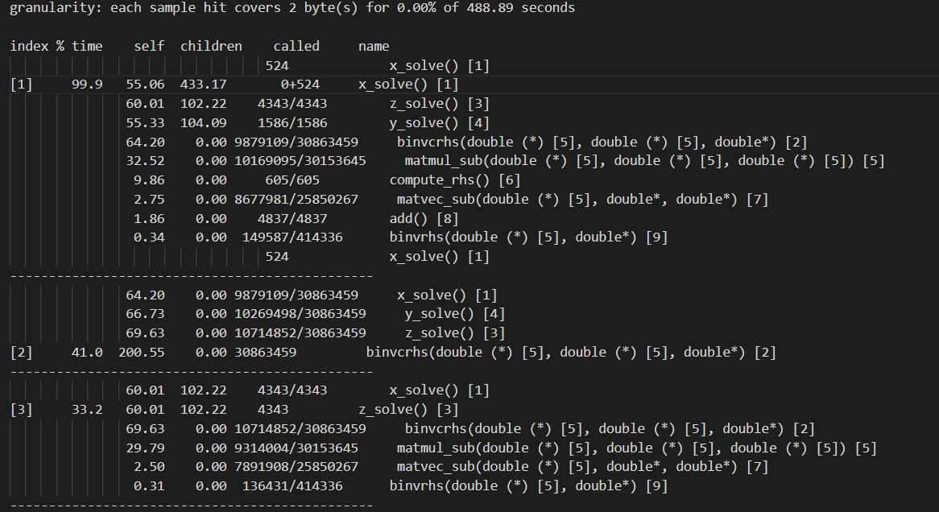
Results Gprof OMP
Fig 12 bt.B.32

Slide 16
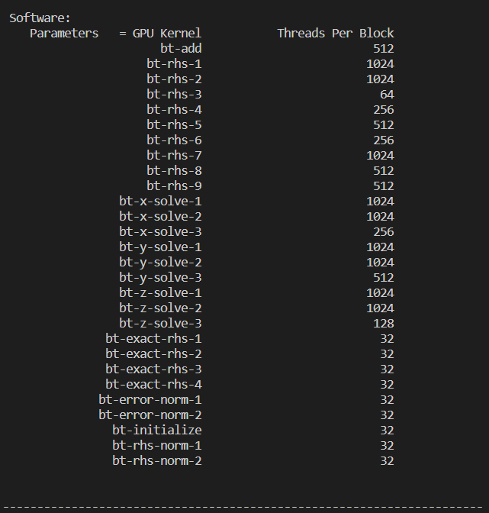
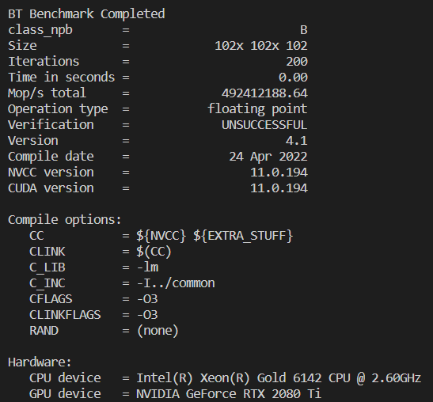
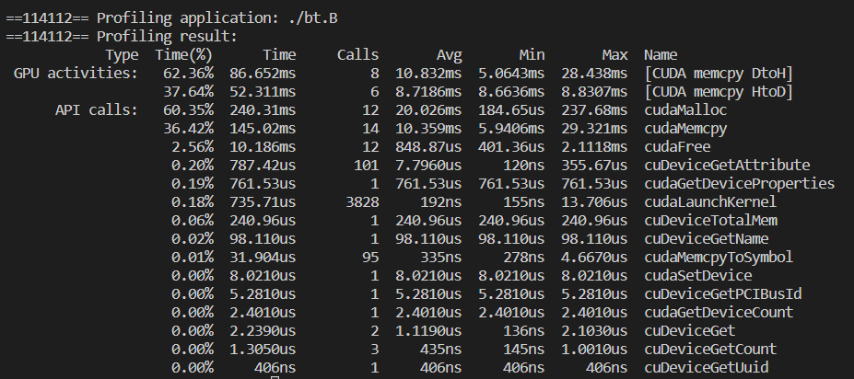
Results Nvprof CUDA
Fig 13 bt.B

Slide 17
Results Of Other Kernels
We have successfully tested OMP codes for all the 8 kernels. The NAS NPB documentation has an Overall performance of HPC around the world for these 8 kernels.
For our reference we have selected 3 HPC to compare our analysis to Hipergator.
Intel Paragon(SunMos turbo)
Thinking Machines CM-500
Fujitsu VPP700
The documented results for HiPerGator : Link

Slide 18
Summary
Tested MPI,OMP and CUDA programs for NAS NPB kernel.
A compendious analysis of performance of HiPergator.
Profiling tools : Gprof, ScoreP and Nvprof.
How classes and ranks can affect the performance of a code.
A brief view on CFD Applications.
Conclusion on which Programming model would one choose.
https://www.nas.nasa.gov/software/npb.html

Slide 19
References
https://www.nas.nasa.gov/software/npb.html
https://www.nas.nasa.gov/assets/pdf/techreports/1994/rnr-94-007.pdf
https://en.wikipedia.org/wiki/NAS_Parallel_Benchmarks#:~:text=NAS%20Parallel%20Benchmarks%20(NPB)%20are,the%20NASA%20Ames%20Research%20Center.
https://digitalcommons.unl.edu/cgi/viewcontent.cgi?article=1149&context=nasapub

Slide 20
DEMO
MPI demo with gprof and scorep for IS kernel
Class size = B/C (As time stamps are clear)
OMP demo with gprof for BT kernel
Class size = B/C (As time stamps are clear)
CUDA demo with nprof for BT kernel
Class size = B/C (As time stamps are clear)

